Slide 1
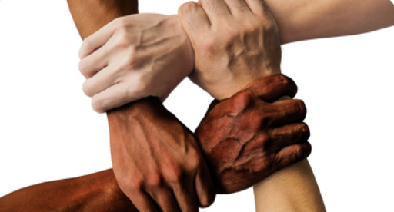
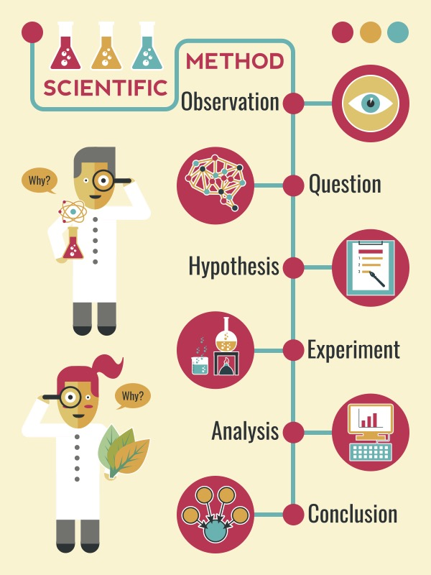
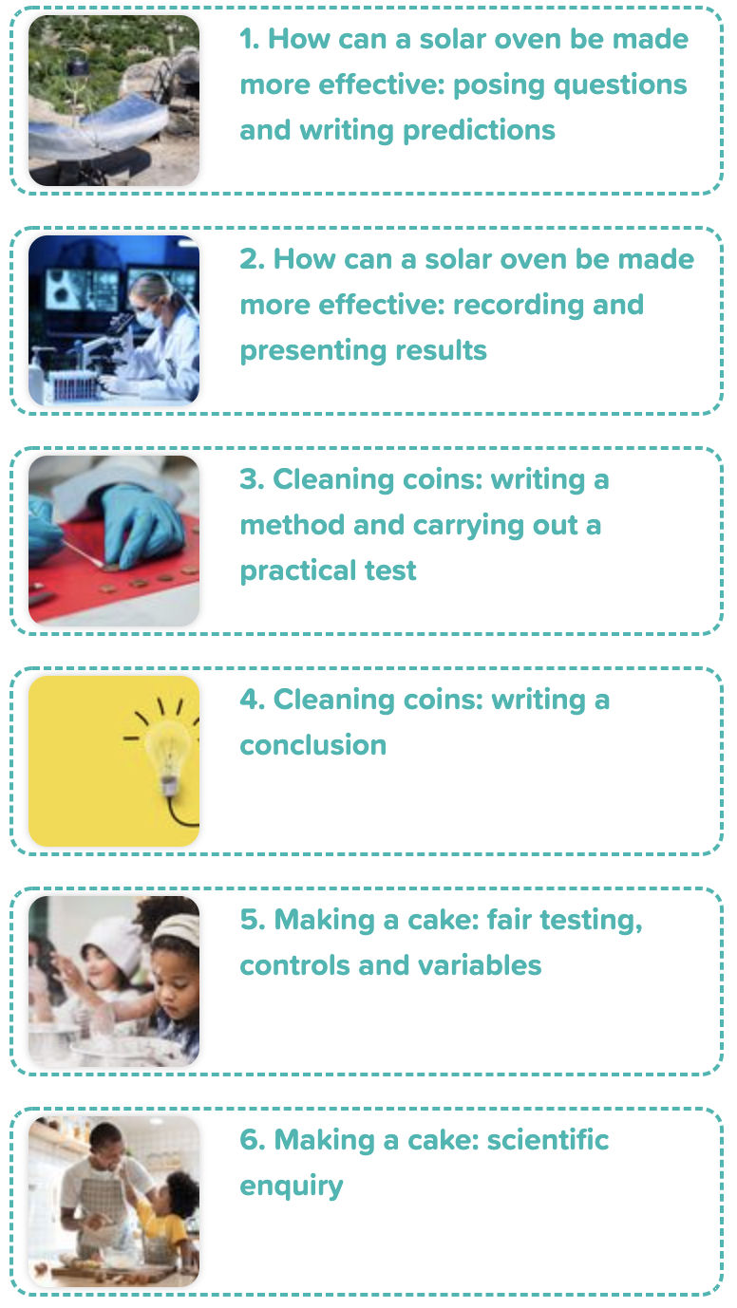
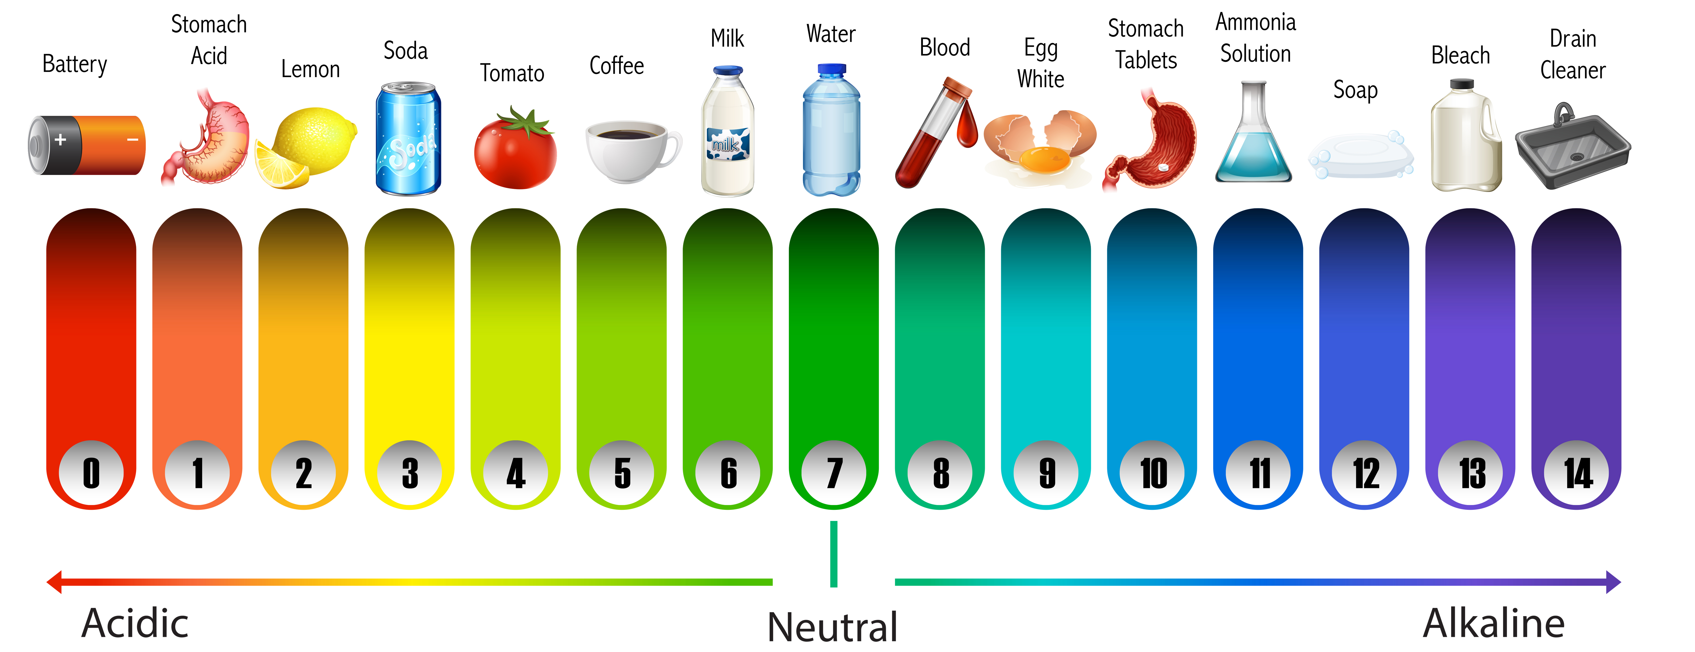
Careers connected to scientific enquiry:
lab technician, research scientist
Knowledge Organiser: Scientific Enquiry
Careers connected to the human body:
doctor, nurse, massage therapist, personal trainer, theatre technician
The Scientific Method
fair test –
where one variable is changed, and all other elements are kept the same
The Scientific Method
Lesson Sequence
Comparative / fair testing
Changing one variable to see the effect on another, whilst keeping all others the same.
1. How can a solar oven be made more effective: posing questions and writing predictions
2. How can a solar oven be made more effective: recording and presenting results
Research
Using secondary sources of information to answer scientific questions.
variable - something that is changed
3. Cleaning coins: writing a method and carrying out a practical test
control experiment - an experiment that is used to compare other experiments where there are variables
Observation over time
Observing changes that occur over a period of time, ranging from minutes to months.
4. Cleaning coins: writing a method
Pattern-seeking
Identifying patterns and looking for relationships in enquiries where variables are difficult to control.
The pH Scale
5. Making a cake: fair testing, controls and variables
Identifying, grouping and classifying
Identifying observations to name, sort and organise items.
6. Making a coin: scientific enquiry
Problem-solving
Applying prior scientific knowledge to find answers to problems.
Developing Experts Copyright 2022 All Rights Reserved

Slide 2
Knowledge Organiser: Scientific Enquiry
Careers connected to the human body:
doctor, nurse, massage therapist, personal trainer, theatre technician
Before and After Test
Name the stages of the Scientific Method
Katie wants to know ‘Which materials are the bounciest?’
Katie’s method: To drop a range of balls from a certain height and then measure how high they bounce. Draw the possible variables might Katie use.
Variable 1
Variable 2
Variable 3
Variable 4
Variable 5
_______
__________
_________
Katie has recorded her results in the table below. Draw a graph for the data in the table.
__________
Type of ball | Height the ball was dropped from | Height the ball bounced
Ping pong ball | 60 cms | 30 cms
golf ball | 60 cms | 40 cms
tennis ball | 60 cms | 42 cms
football | 60 cms | 60 cms
_________
__________
What can you learn from the data shown in the table?
________________________________________________________________________________________________________________________________________________________________________________________________
Developing Experts Copyright 2022 All Rights Reserved

Slide 3
Unit Rocket Words: Year 3 – Scientific Enquiry
Rocket Words
scientific investigation | finding answers to questions using research methods
prediction | explaining what you think might happen
plausible | having a reason
record | writing the measurement of something
data | a set of facts or numbers used to learn about something
method | instructions for carrying out an experiment
control experiment | an experiment that is used to compare other experiments where there are variables
equipment | tools or items that are needed
enquiry | a question to find something out
practical | the performing of a scientific experiment
conclusion | the end result or outcome
fair test | where one variable is changed and all other elements are kept the same
Developing Experts Copyright 2022 All Rights Reserved

