Slide 1
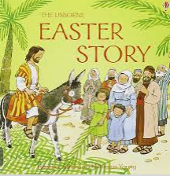
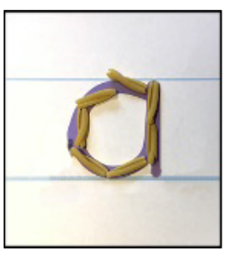
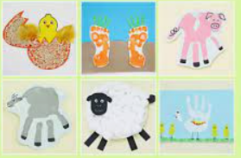
Communication, Language and Literacy Follow and recall instructions Listen and respond to peers and adults Record lists, captions, labels and sentences Begin to write for a purpose Sequence ideas together Recognise key features such as finger spaces and full stops. |  | Books The texts we will be using during this topic will include: | Mathematics Representing, sorting and composition of 9 and 10 Ordering numerals to 10 Number 10 Bingo Comparing numbers within 10 Counting back from 10 Making 10 3D shapes Building and printing with 3D shapes Patterns
Phonics - Continue phase 3 phonics, concentrating on digraphs Recognise digraphs and the sounds they make. Segment and blend phase 3 words using phonic knowledge. Read simple sentences. Recognise and spell ‘tricky’ words. | Handwriting Continue Letterjoin and writing printed lowercase letters in conjunction with phonics lessons. Begin Perceptuo-Motor programme. |  | Physical Development Space Invaders The skills we will learn will involve: Strike, React, Assess Knights and Dragons The skills we will learn will involve: Attack, Defend, Strategy We will also learn to show respect to self, others and equipment.
 |  | Food Glorious Food Spring 2 Hedgehogs class
Expressive Arts and Design Being imaginative and expressive – Number songs, farm songs -sing broadly in tune with a limited pitch. Garden centre role play, sand and water. Creating with materials – Farm animal collage, butterfly painting, Easter cards, Easter craft, Bible story paintings, playdough, Mothers day. |  | Personal, Social and Emotional Development Self-regulation: Listening and following instructions In this unit, the children will learn why it is important to be an honest, thoughtful and resilient active listener who can respond to instructions and how they can become one. | Understanding the World Why is Easter special to Christians? Vegetables – Explore different types of vegetables Wheat and Flour – Follow instructions accurately and understand the process of making dough. Chicken and eggs – Explain where eggs come from, understand the stages of a chicken’s life and name the parts of a chicken.

