Slide 1
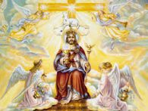
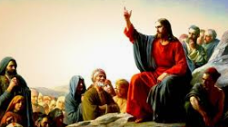
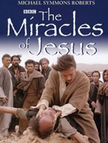
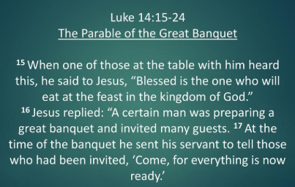

Being a Christian: UKS2 Knowledge mat (U2.6 Y6)
Subject Specific Vocabulary
Jesus | God’s son, who Christians believe came to earth.
Incarnation | God becoming man: God becoming flesh.
Kingdom of God | A spiritual realm over which God reigns.
 |  |  | Exciting Books
Parables | A simple story used to illustrate a moral or spiritual lesson, as told by Jesus in the Gospels. | Sticky Knowledge – Kingdom of God: For Christians, what kind of King was Jesus?
Chief Priests | A person who has power of authority over others. | Jesus came to earth to save all people. Jesus wanted people to serve others especially those who are in need and vulnerable. Jesus has many names such as: Messiah, Son, King and Saviour.
 |  | Christians believe that incarnation happened so that people could enter heaven.
 |  | There are many parables that explain what the Kingdom of God is like: The Feast – Luke 14:12-24 and The Tenants in the Vineyard – Matthew 21: 35-46 In Luke 4:1-13, Jesus declined an offer from the devil to be King of all the nations of the earth.

Slide 2
Being a Christian: UKS2 Knowledge mat (U2.6 Y6)
Subject Specific Vocabulary |  | Sticky Knowledge – Kingdom of God: For Christians, what kind of King was Jesus?
Jesus
 |  | Why did Jesus come to Earth?
Incarnation
Kingdom of God
 |  | What are some of the names they give to Jesus?
Parables |  | Why did Jesus come to Earth?
Chief Priests
Luke 14:15-24
 |  | What parables explains what the Kingdom of God is like?

