Slide 1
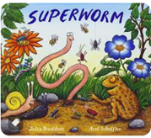
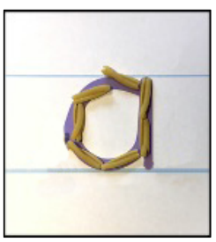
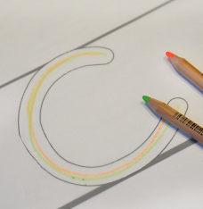
Communication, Language and Literacy Organise talk and sequence ideas together to express opinions about own interests Write in sentences using capital letters and full stops Sequence ideas together. Begin to add detail to writing. Writing should contain consistent use of phase 3 sounds and tricky words. |  | Books The texts we will be using during this topic will include: | Mathematics Building numbers beyond ten Counting patterns beyond ten Adding more Taking Away Spatial reasoning Match, rotate and manipulate Compose and decompose
Phonics – begin level 4. Segment and blend CVCC, CCVC words and adjacent consonants e.g tree, flag, jump. Decode polysyllabic words. Read sentences using phonic knowledge to decode unfamiliar words. Read and spell all level 2, 3 and some level 4 ‘tricky’ words. | Handwriting Continue Letterjoin and writing printed lowercase letters in conjunction with phonics lessons. Continue Perceptuo-Motor programme. |  | Physical Development Olympians The skills we will learn will involve: Run, jump and throw Pirates The skills we will learn will involve: Catch, move and assess We will also learn to build resilience.
 |  | The Great Outdoors Summer 1 Hedgehogs class
Expressive Arts and Design Being imaginative and expressive – Number songs, using instruments to create vehicle sounds. Train station and garage role play, sand and water. Creating with materials – junk model vehicles, playdough, printing in clay, water colours, story paintings |  | Personal, Social and Emotional Development Building relationships: My family and friends In this unit, the children will learn how we all have different beliefs and celebrations, what characteristics make a good friend, and how we need to listen to one another. | Understanding the World Plants Where do plants come from? How to look after plants Insects What are insects and invertebrates? Where do insects and invertebrates live? Discover more about insects and invertebrates

