Slide 1

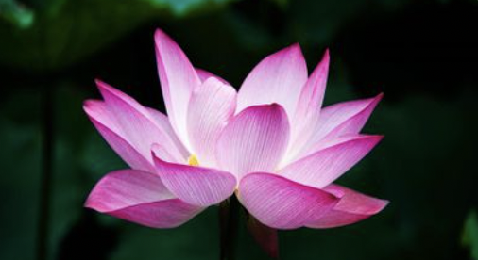










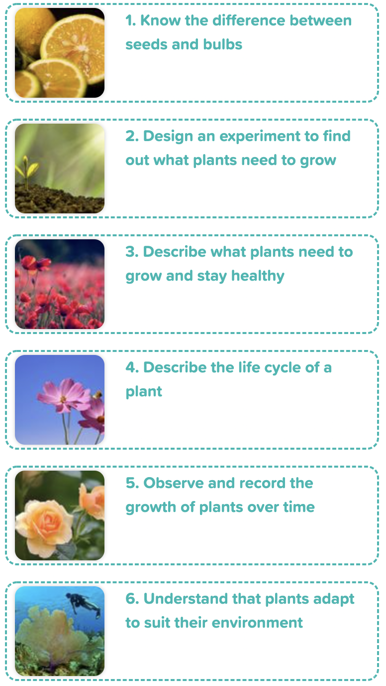
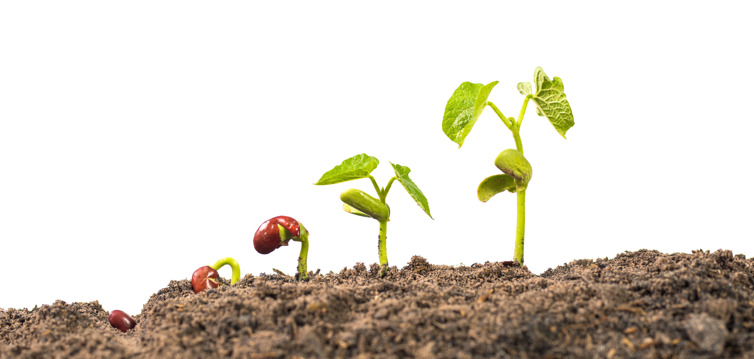
Careers connected to plants:
horticultural management, plant biologist, plant pathologist
Knowledge Organiser: Plants
Careers connected to the human body:
doctor, nurse, massage therapist, personal trainer, theatre technician
Life Cycle of a Plant
What Plants Need to Grow
Lesson Sequence
A plant germinates when it starts to grow. Inside a seed/bulb is the baby plant. Seeds are covered with a seed coat.
Seeds need the right conditions to grow. Seeds need water, air and the right temperature to grow.
Plants need water to survive. Plants get water through their roots.
Plants need the right temperature to grow.
Plants need sunlight to help them grow and make their own food.
Plants need room to grow. Plants need time to grow. It can take days, months or even years for them to grow.
1. Know the differences between seeds and bulbs
2. Design an experiment to find out what plants need to grow
3. Describe what plants need to grow and stay healthy
Life Cycle of a Plant
Plants begin life as seeds or bulbs. They need soil, air and water to grow. Plants grow into young plants called seedlings. Plants grow flowers and fruits. These produce seeds. When the plant is pollinated, the seeds find their soil. The process starts again!
4. Describe the life cycle of a plant
5. Observe and record the growth of plants over time
6. Understand that plants adapt to suit their environment
Developing Experts Copyright 2022 All Rights Reserved

